Slide 1

Progress Report
NFU Hubert

Slide 2
Empirical Evaluations on Momentum Effects of Taiwan
Main Points of the Paper
“
2019
Mu-En Wu
Department of Information and Finance Management National Taipei University of Technology, Taiwan
Wei-Ho Chung
Department of Electrical Engineering National Tsing Hua University, HsinChu, Taiwan
”
International Journal of Information Technology and Decision Making:I.F.:4.26

Slide 3
Abstract
The Efficient-Market Hypothesis (EMH) suggests that predicting market moves is tough due to quick reactions to new information. However, some strategies, like Momentum Strategy, seem profitable in practice. We explored this in Taiwan's stock market using real data. Testing four strategies on TAIEX Futures from Jan 2010 to Mar 2015, we found market inefficiencies. Different stop-loss and take-profit methods confirmed the momentum effect. Managing these approaches is crucial for strategy success, improving trading quality beyond just technical details.

Slide 4
Trading strategy
The paper give us two types of trading strategies.
1. Mean reversion strategy
This strategy expects prices to come back to their average after big swings. If prices rise (or fall) too much, we take the opposite position by selling (or buying). Bollinger Bands is a famous technique for this.
2. Momentum strategy
On the other hand, momentum strategies work differently. They involve tactics like Open Range Breakout, where we buy (or sell) when prices break the highest (or lowest) point within a particular timeframe. Another common approach is trading based on price levels set by past changes. Many studies explore momentum effects in finance, explaining them through reasoning or trading behaviors. This paper offers a fresh approach, using trading methods to confirm this phenomenon.

Slide 5
Methods
This paper employs the following four types of day trading strategies
1. Momentum strategy ( MTM Base)
2. Momentum strategy with a 30-point stop loss ( MTM Stop-30 )
3. Momentum strategy with a 60-point take profit ( MTM Stop-60 )
4. Momentum strategy with a 30-point stop loss and 60-point take profit ( MTM Stop-30, 60 )
How to trade?
When the stock price breaks the set threshold price within the trading day, we take long (short) positions and close them at the end of the market trading time.

Slide 6
Formula
The testing is done in groups of 100 trades each, calculating the statistical data for each group.
Formula:
Win Rate = Number of trades won / 100
Odds = average profit / average loss
Expectation of net profit = Win Rate * ( 1 + odds ) – 1
Average earning points = net profit / 100

Slide 7




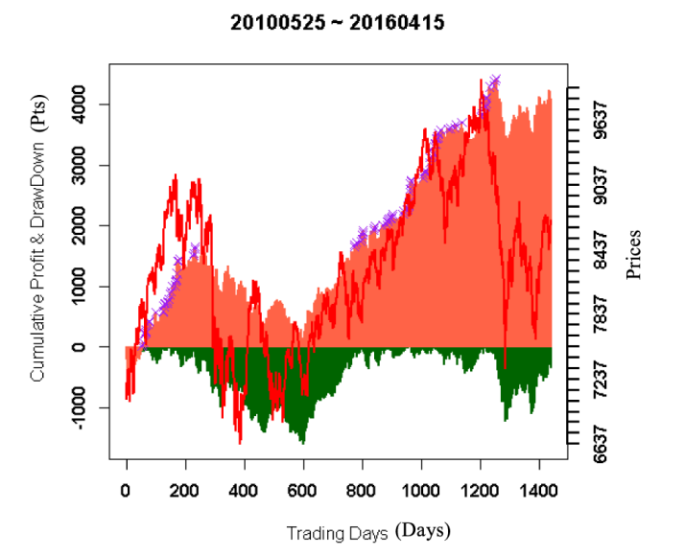
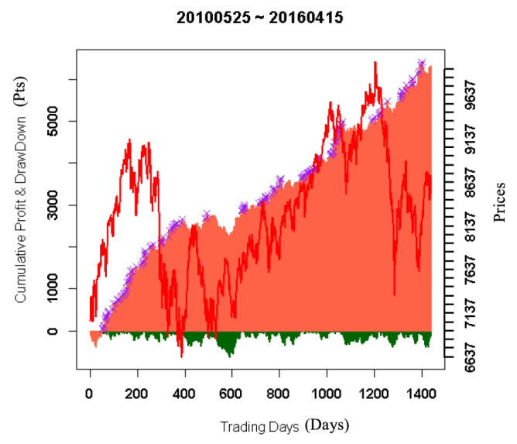
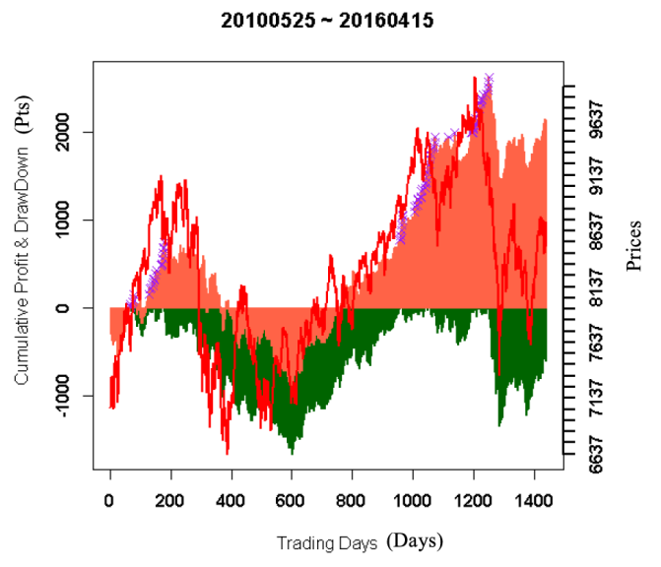
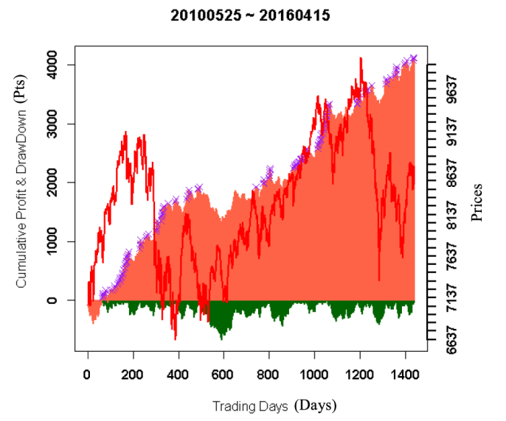
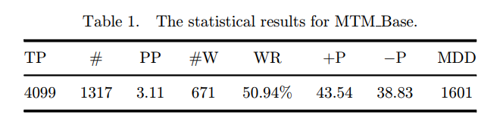
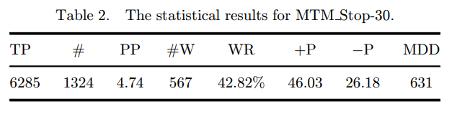
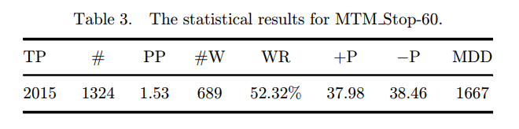
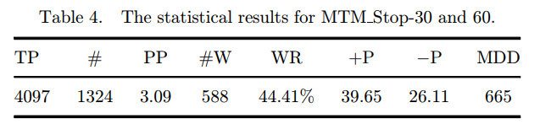
Results
The test results showed that momentum strategies are effective in Taiwan's index futures market. Additionally, using stop-loss instead of take-profit led to higher profits, highlighting the momentum effect in the market.
red line = market price
red area = cumulative profit
green area = cumulative drawdown
purple x = max cumulative profit
MTM Base
MTM Stop-30
MTM Take-60
MTM Stop&Take-30, 60

Slide 8
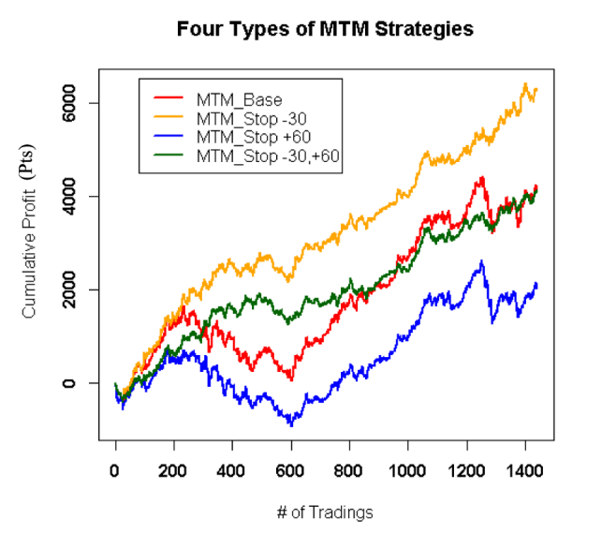
Results
Compares the four types of strategies

Slide 9
Finding the best parameters by using MDD and SQN
The most stable profit can be assessed using two performance indicators:
TP (Total Profit) and MDD (Maximum Drawdown) Ratio:
This ratio is called MAR index, and a higher value indicates a better strategy. As TP goes up, MDD goes down, leading to a larger MAR. This indicates smaller fluctuations in gains and losses and more stable profit growth.
System Quality Number (SQN):
Introduced by Van Tharp, this value is calculated as (Average Profit / Standard Deviation of Profits) * Square Root of Number of Trades. If SQN > 2, it suggests a fairly good trading strategy.

Slide 10
Conclusion
This paper explores the momentum effect in Taiwan's index futures market. Momentum strategies confirm the profitability in the market. Additionally, incorporating stop-loss and take-profit methods into consideration verifies the momentum effect phenomenon in Taiwan's stock market. According to test results, the stop-loss method appears to effectively enhance the performance of trading strategies, while the take-profit method does not. This phenomenon is referred to as the momentum effect in Taiwan's index futures.

Slide 11
Program Report
“
”

Slide 12
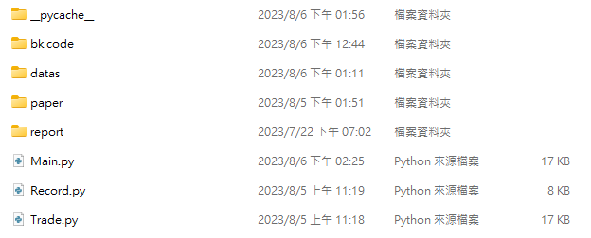





Code
The current code standardizes data formats and supports backtesting for both the US and Taiwan stock markets. In the future, it can accommodate additional markets. If real trading is to be implemented, pathways for real trading have also been prepared.

Slide 13
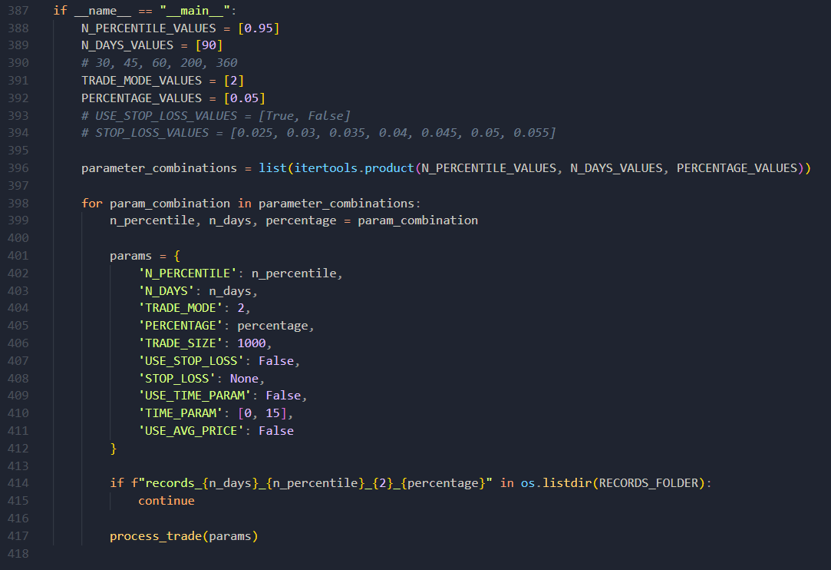
Main.py
You can adjust parameter values based on the items shown in the following images and use the method provided in the paper to find the optimal parameter solution.

Slide 14
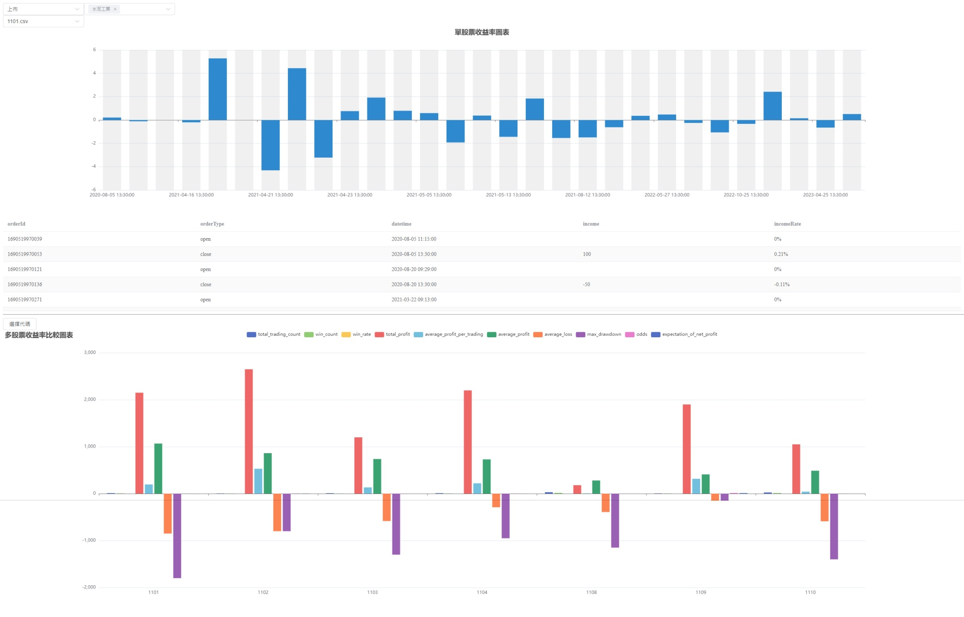
Visualization
https://laiiting.github.io/StockEchart/

Slide 15

Thanks

Slide 16

 | Now (Done) | Future (Not yet)
Paper Reading | Empirical Evaluations on Momentum Effects of Taiwan | Call auction, continuous trading and closing price formation
Simulated trading | US stock market and TW stock market | Extend the trading duration beyond day trading ( Handled by NFU )
Categorizing stock types | TW stock market | US stock market ( Handled by CCU )
Stock events | (Null) | US stock events and TW stock events Ex: Annual General Meeting、FED Meeting、CPI、Financial Reports、News ( U.S. Handled by CCU, TW Handled by NFU )
Test parameters | Using basic parameters only | Find the optimal parameters (Using TP/MDD ratio and SQN)
GUI - Results | Comparing the simulated results for the TW stock market | Adding simulated results for the US stock market
GUI - Interaction | Switching charts for different stocks. | Users can modify parameters and send computation requests to the server.

